Slide 1



Lead Score Case Study
Submitted by :
Mr. Muna Sahu
Mr. Pushkar Rajwadikar
DS C43 | Lead Scoring Case Study | 2022

Slide 2

Problem Statement
X Education offers online courses to industry professionals. Multiple websites and search engines, such as Google, are used by the company to promote its courses.Once these visitors reach the website, they may explore the courses, submit a form for the course, or view videos.
When these individuals submit a form with their email address or phone number, they are considered leads. Additionally, the organization gets leads from earlier recommendations.
After acquiring these leads, sales team members begin making calls, sending emails, etc. Through this procedure, some leads are converted, but the majority are not. The average conversion rate for leads at X education is about 30%.

Slide 3

Business Goal:
X Education needs help in selecting the most promising leads.
The leads that are most likely to convert into paying customers
The company needs a model wherein you a lead score is assigned to each of the leads such that the customers with higher lead score have a higher conversion chance and the customers with lower lead score have a lower conversion chance.
The CEO, in particular, has given a ballpark of the target lead conversion rate to be around 80%

Slide 4

Strategy
Sourcing the analytical data
Data cleansing and preparation
Exploratory data analysis
Features Scaling
Splitting the data into Train and Test datasets.
Building a Logistic Regression model and determine the Lead Score.
Evaluating the model using several measures, such as Specificity and Sensitivity or Precision and Recall.
Applying the model with the highest sensitivity and specificity to the Test data.

Slide 5
Problem solving methodology
Detailed procedures to solve the business problem
Importing Libraries
Understanding the Data, Data Inspection and Cleaning
Exploratory Data Analysis
Data Preparation
Test-Train Split
Rescaling the features with MinMax Scaling
Model Building using Stats Model & RFE
Plotting the ROC Curve
Finding Optimal Cutoff Point
Making predictions on the test set

Slide 6
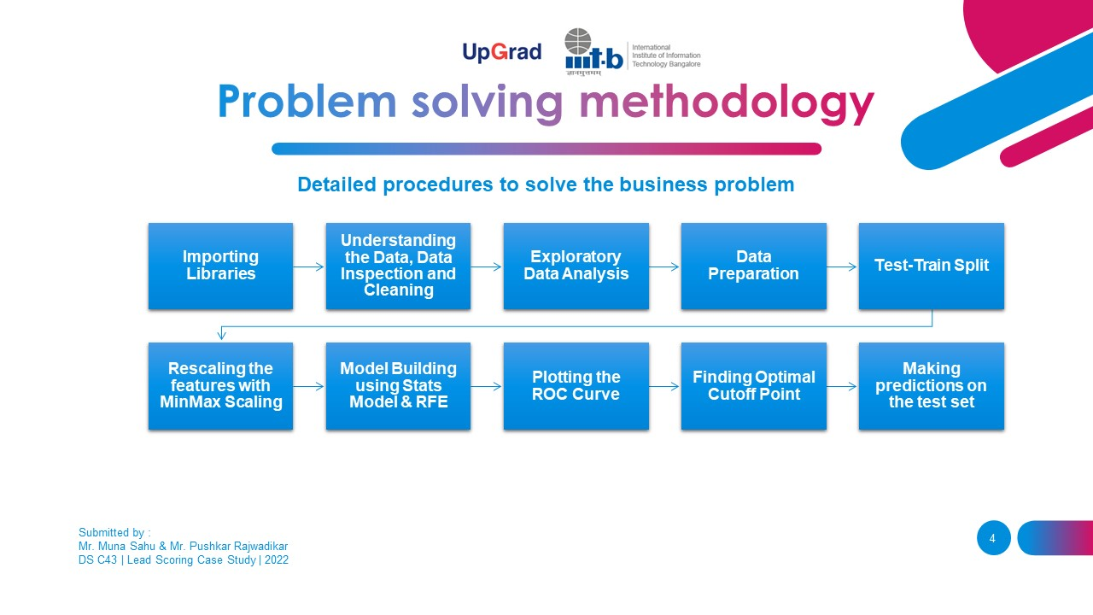
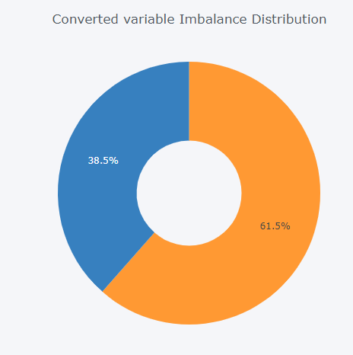
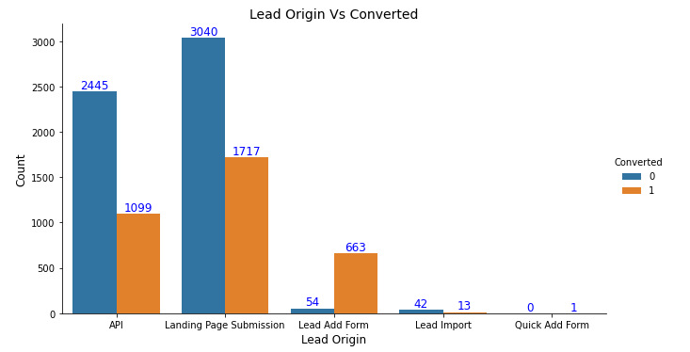
Exploratory Data Analysis
EDA Findings’
We have around 39% Conversion rate in Total.
The conversion rates were high for Total Visits, Total Time Spent on Website and Page Views Per Visit.

Slide 7
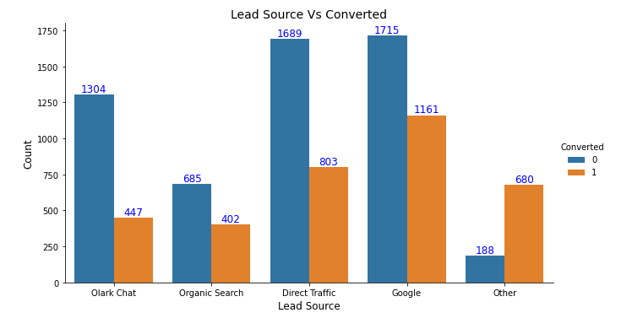
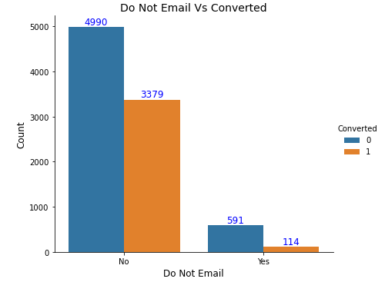
Exploratory Data Analysis
EDA Findings’
From above plot we can see that maximum conversions are there when lead is obtained from Google.
Majority of customers opted to be contacted through emails and the conversion rate is also higher for these customers. Also, conversion rate is very for customers opting to not receive email from the company.

Slide 8
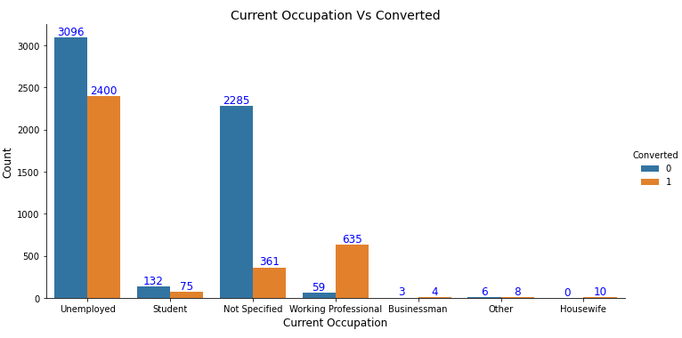
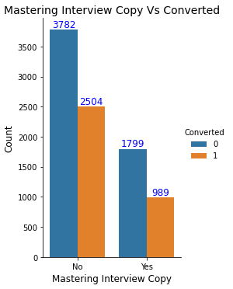
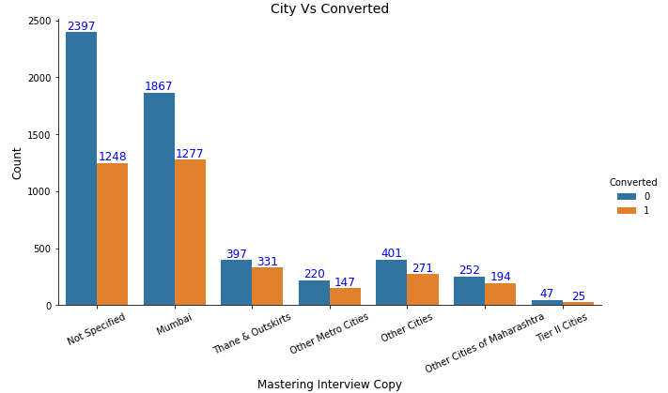
Exploratory Data Analysis
EDA Findings’
Maximum customers that converted are unemployed. We can also observe that working professionals are more likely to convert where customers who chose not to share their occupation are less likely to be converted.
Customers who do not want a free copy of Mastering the Interview have higher conversion rate.
The graph shows that maximum number of leads are from Mumbai whereas conversion rate is higher for Thane Outskirts.

Slide 9
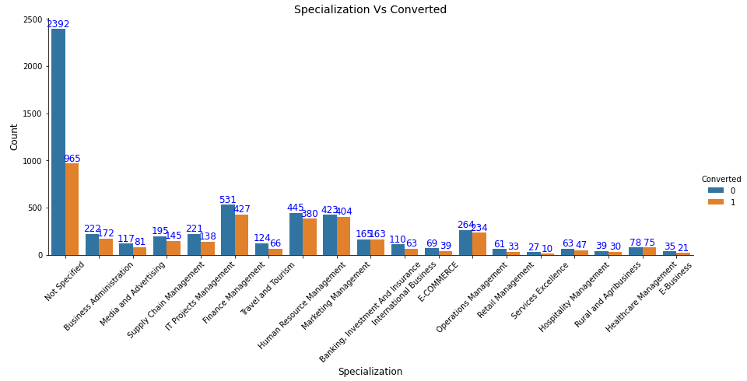
Exploratory Data Analysis
EDA Findings’
Though majority leads are the customers who have not specified their Specialization, the conversion rate is very low.
We can also see that lead conversion rate is higher for Management specializations (Finance, marketing, operations) as well as Banking & Insurance.

Slide 10
Variables Impacting the Conversion Rate
Total Time Spent on Website Lead Origin_Lead Add Form Occupation_Working Professional Occupation_Other Occupation_Unemployed Lead Source_Olark Chat Occupation_Student TotalVisits Do Not Email

Slide 11
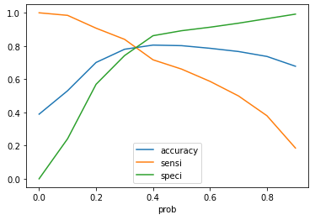
Model Evaluation
Sensitivity and Specificity on Train Data Set
2197
962
495
2067
From the curve above, 0.31 is the optimum point to take it as a cutoff probability.
Accuracy : 78 %
Sensitivity: 84 %
Specificity: 75 %
Confusion Matrix
accuracy sensitivity and specificity for various probabilities.

Slide 12
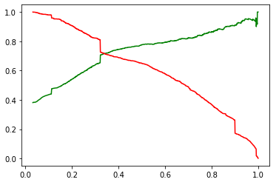
Model Evaluation
Sensitivity and Specificity on Test Data Set
1247
455
184
837
From the curve above, 0.31 is the optimum point to take it as a cutoff probability.
Accuracy : 77 %
Sensitivity: 82 %
Specificity: 73 %
Confusion Matrix
accuracy sensitivity and specificity for various probabilities.

Slide 13



THANK YOU!
Mr Muna Sahu
DS C43 | 2022
+91 9348327393
munasahoo012@gmail.com
Mr. Pushkar Rajwadikar
DS C43 | 2022
+91 7057855533
pushkarrajwadikar2014@gmail.com

